Slide 1

The Atliq Grand Hotels
Sales Analysis

Slide 2
Objective
The objective of hotel sales analysis is to assess the performance of various revenue streams, in order to identify trends, opportunities, and areas for improvement. By analyzing sales data, hotels can optimize pricing strategies, enhance guest experiences, and forecast demand more accurately. This data-driven approach helps in making informed decisions that maximize profitability, improve resource allocation, and identify peak seasons or low-demand periods. Ultimately, the goal of hotel sales analysis is to enhance revenue management, drive customer satisfaction, and maintain a competitive edge in the hospitality industry.

Slide 3
Terminologies

Slide 4
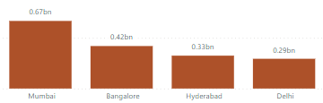
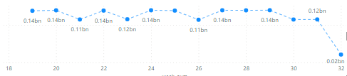
Revenue
Total Revenue earned in the given tenure is 1708771229
Total Revenue generated by City
Revenue trends by week

Slide 5
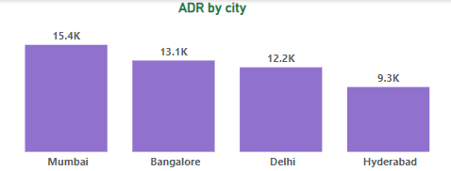
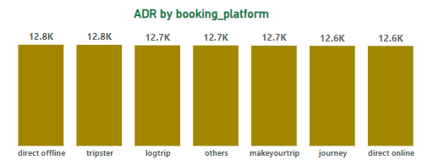
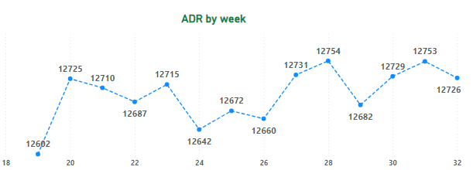
ADR
It is the ratio of revenue to the total rooms booked/sold.
It is the measure of the average paid for rooms sold in a given time period

Slide 6
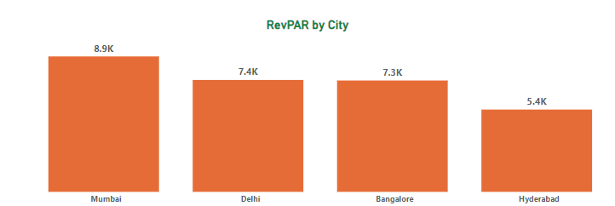
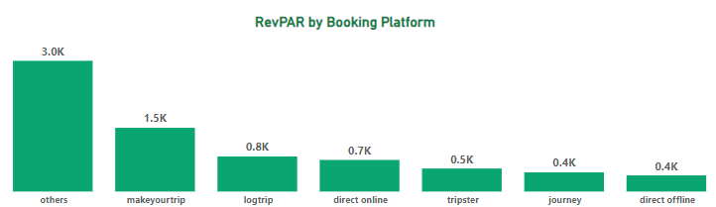
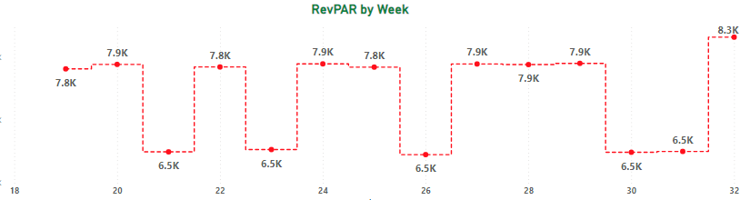
RevPAR
RevPAR represents the revenue generated per available room, whether or not they are occupied. RevPAR helps hotels measure their revenue generating performance to accurately price rooms. RevPAR can help hotels measure themselves against other properties or brands.

Slide 7
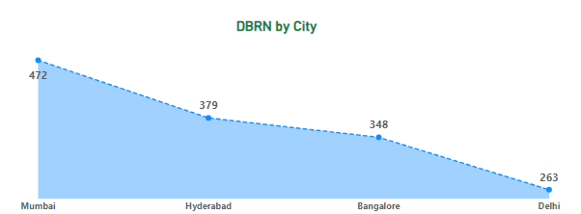
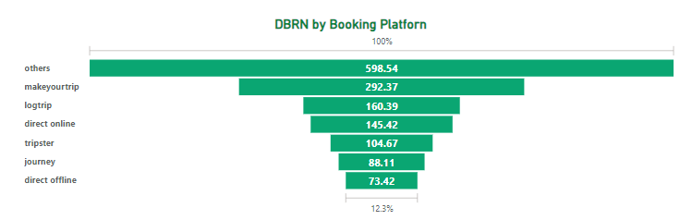
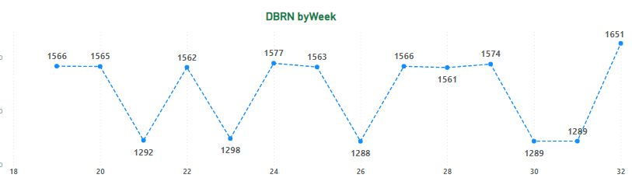
DBRN
This metrics tells on average how many rooms are booked for a day considering a time period.

Slide 8
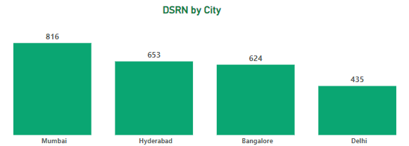
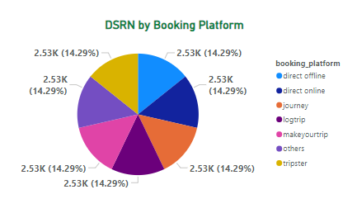
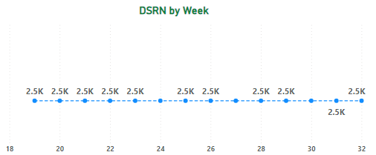
DSRN
This metrics tells on average how many rooms are ready to sell for a day considering a time period

